Slide 1
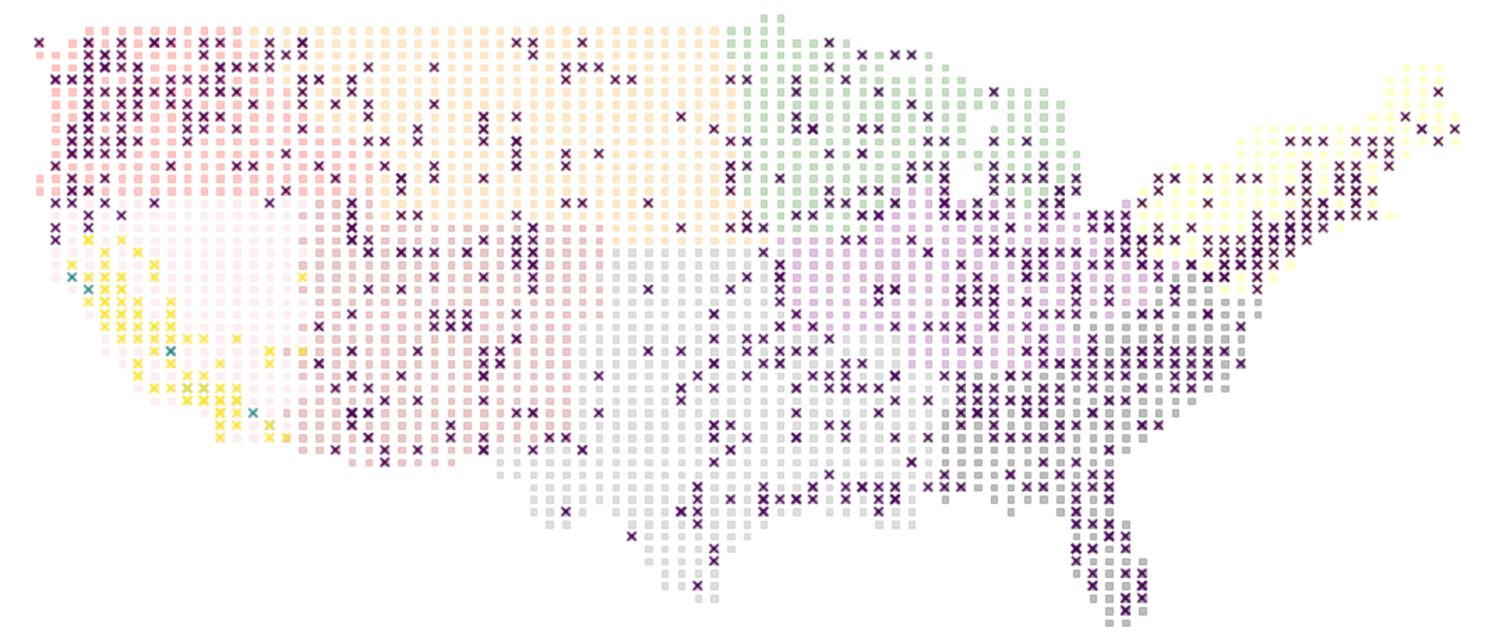
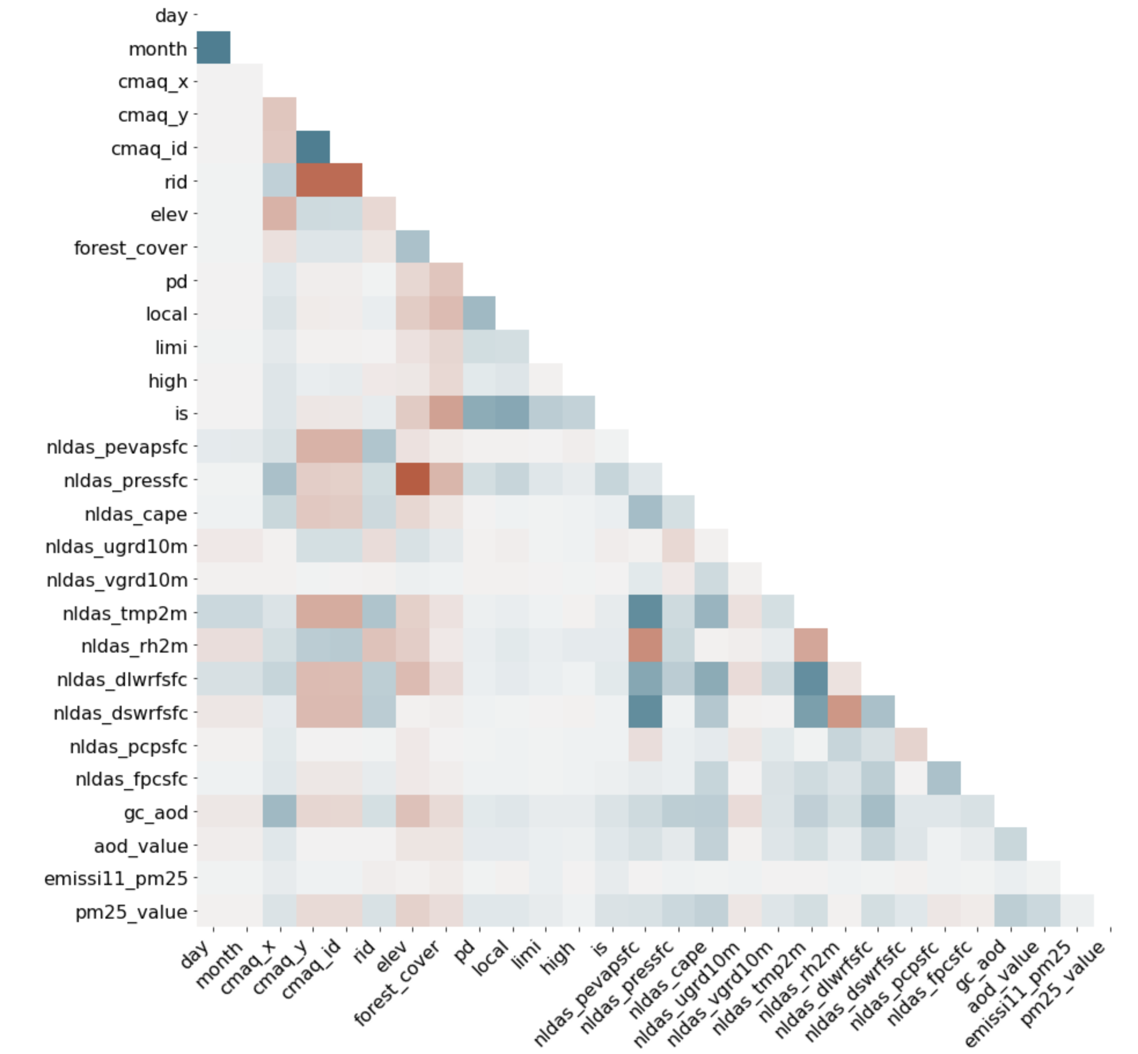
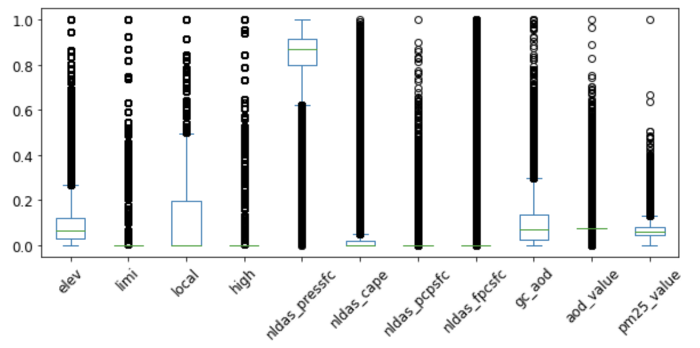
(a)
(b)
(c)

Slide 2
(a)
(b)

Slide 3
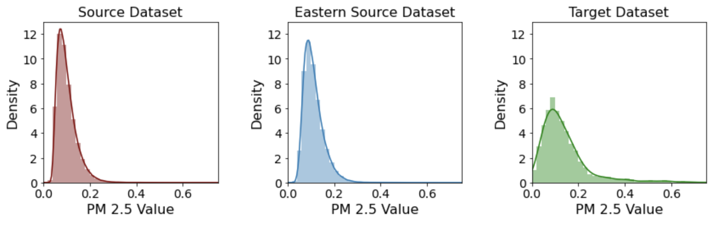
(a)
(b)
(a)
(c)
(b)

Slide 4
(a)
(c)
(b)
(b)
(c)

Slide 5
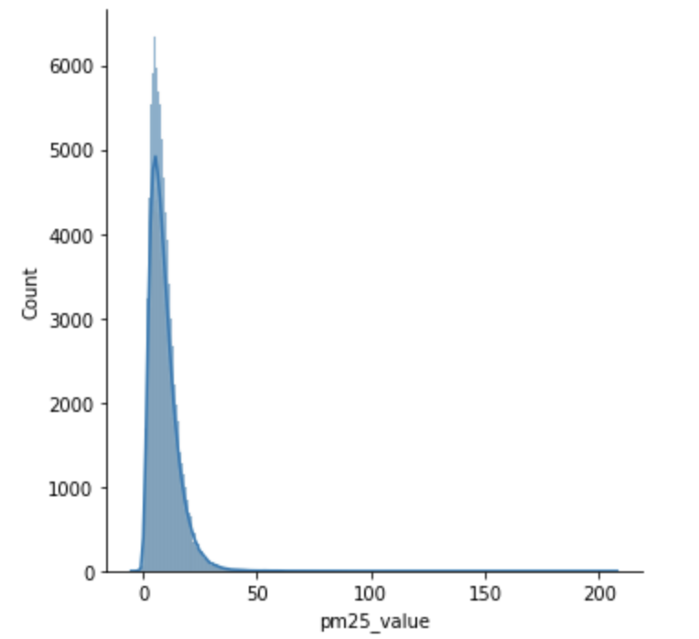
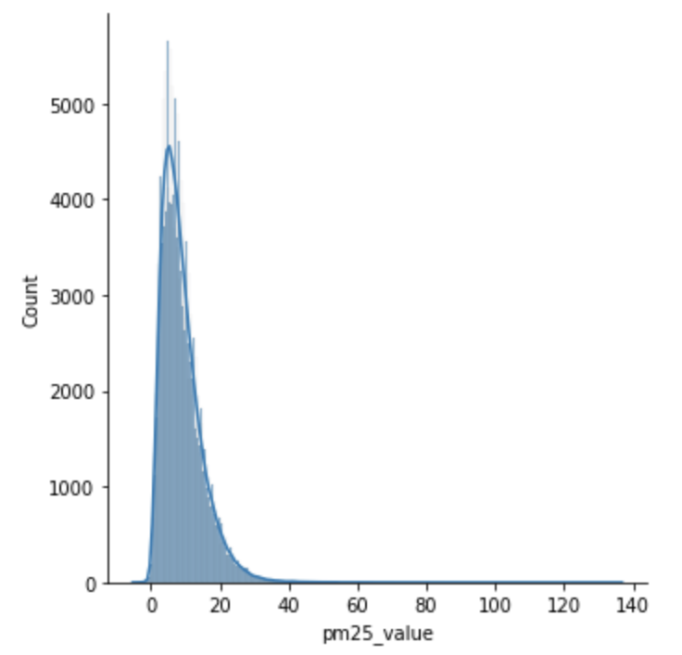
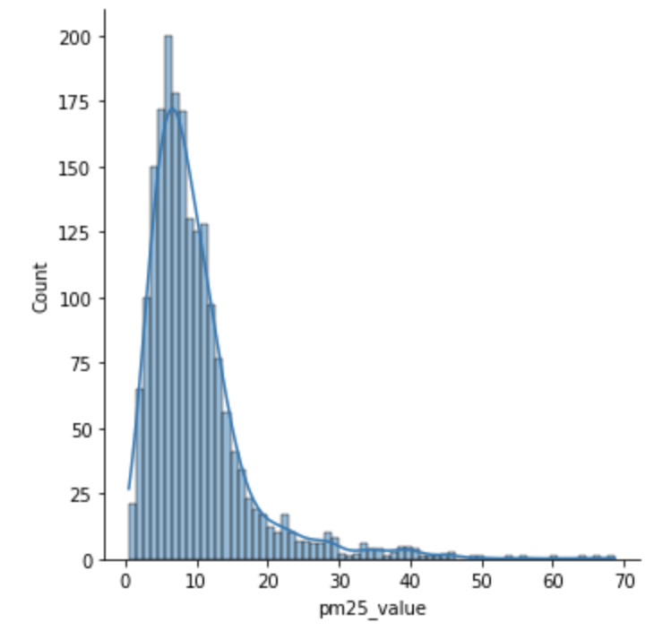

Complete dataset
Source dataset
Target dataset
Test dataset

Slide 6
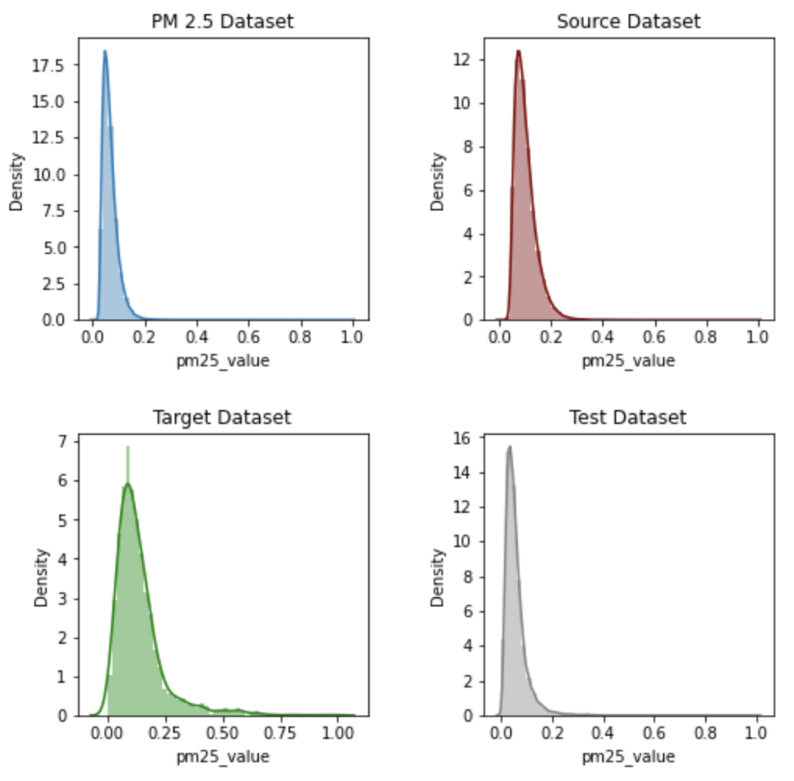

Slide 7
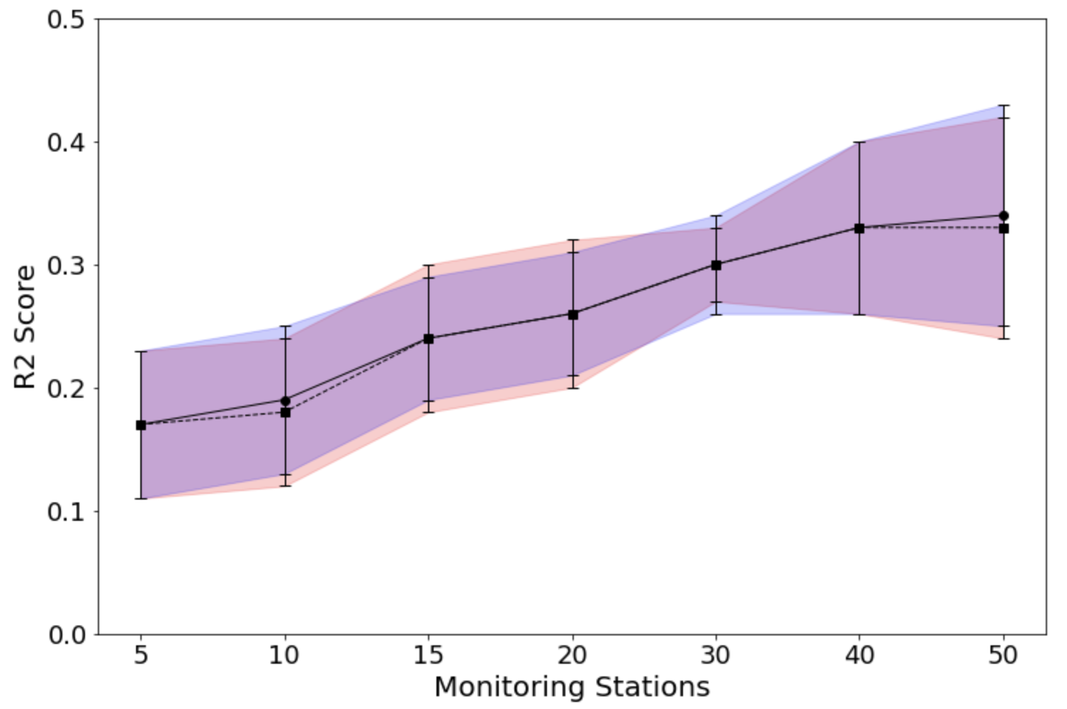
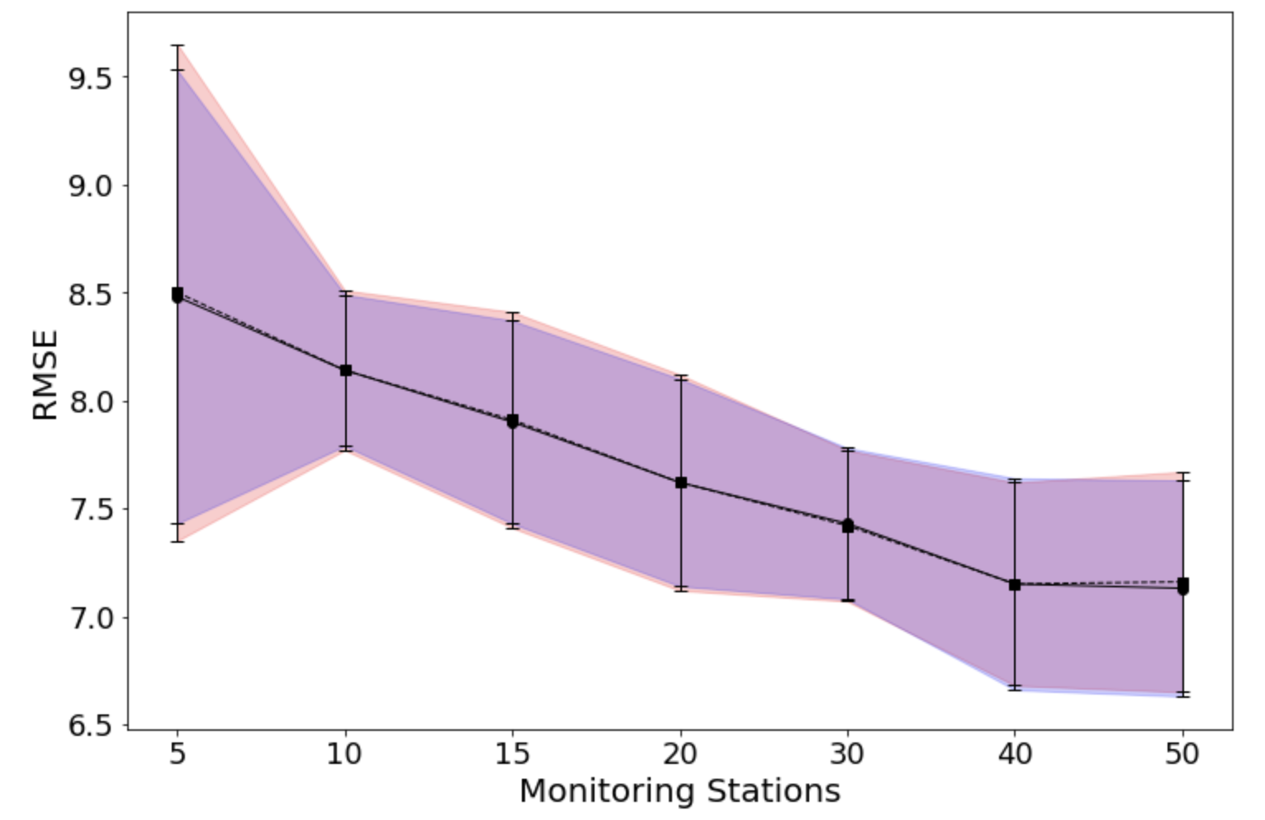

Slide 8
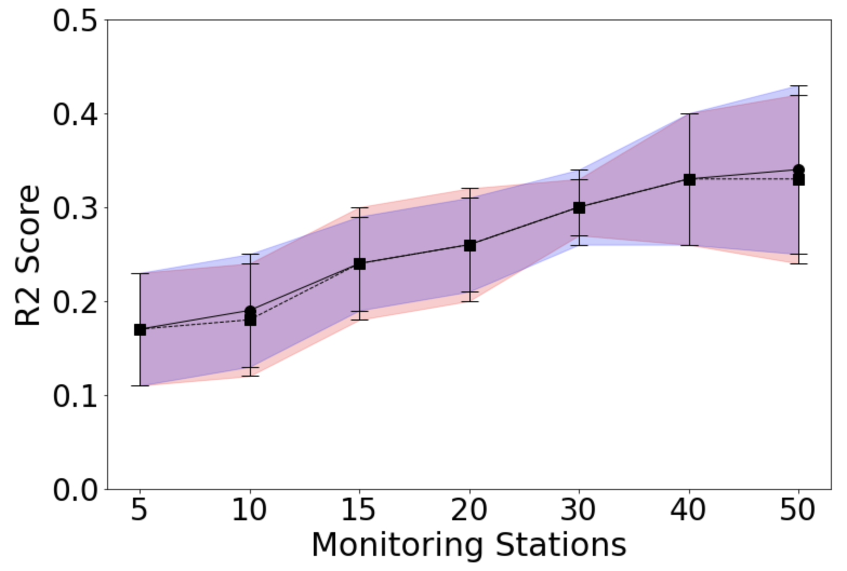
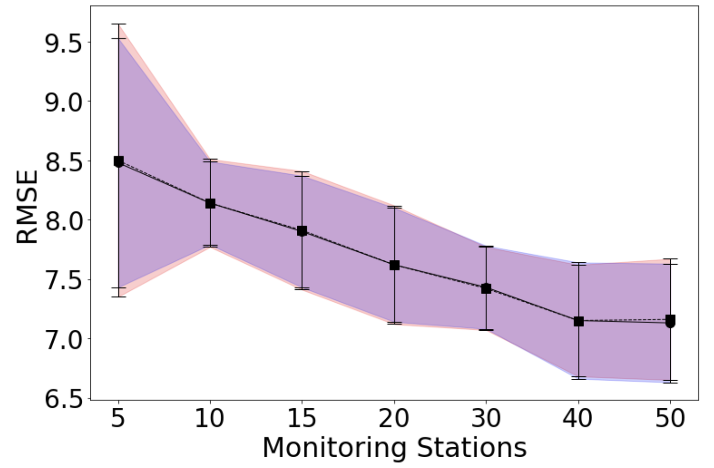

Slide 9
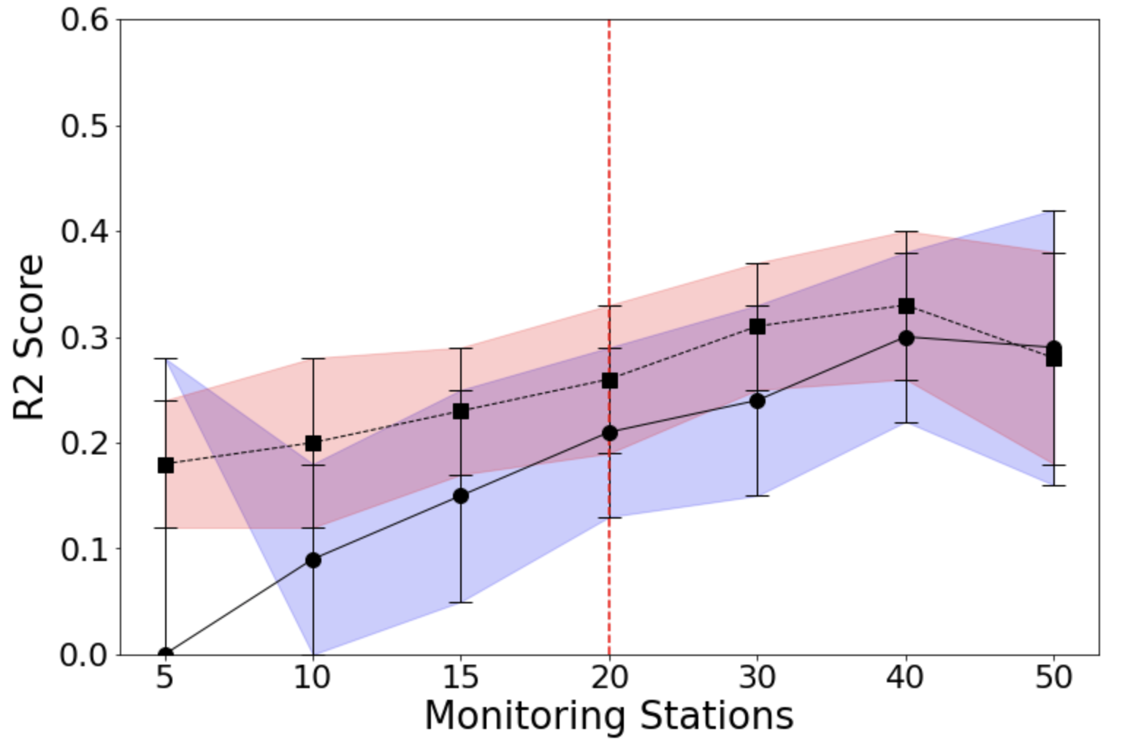
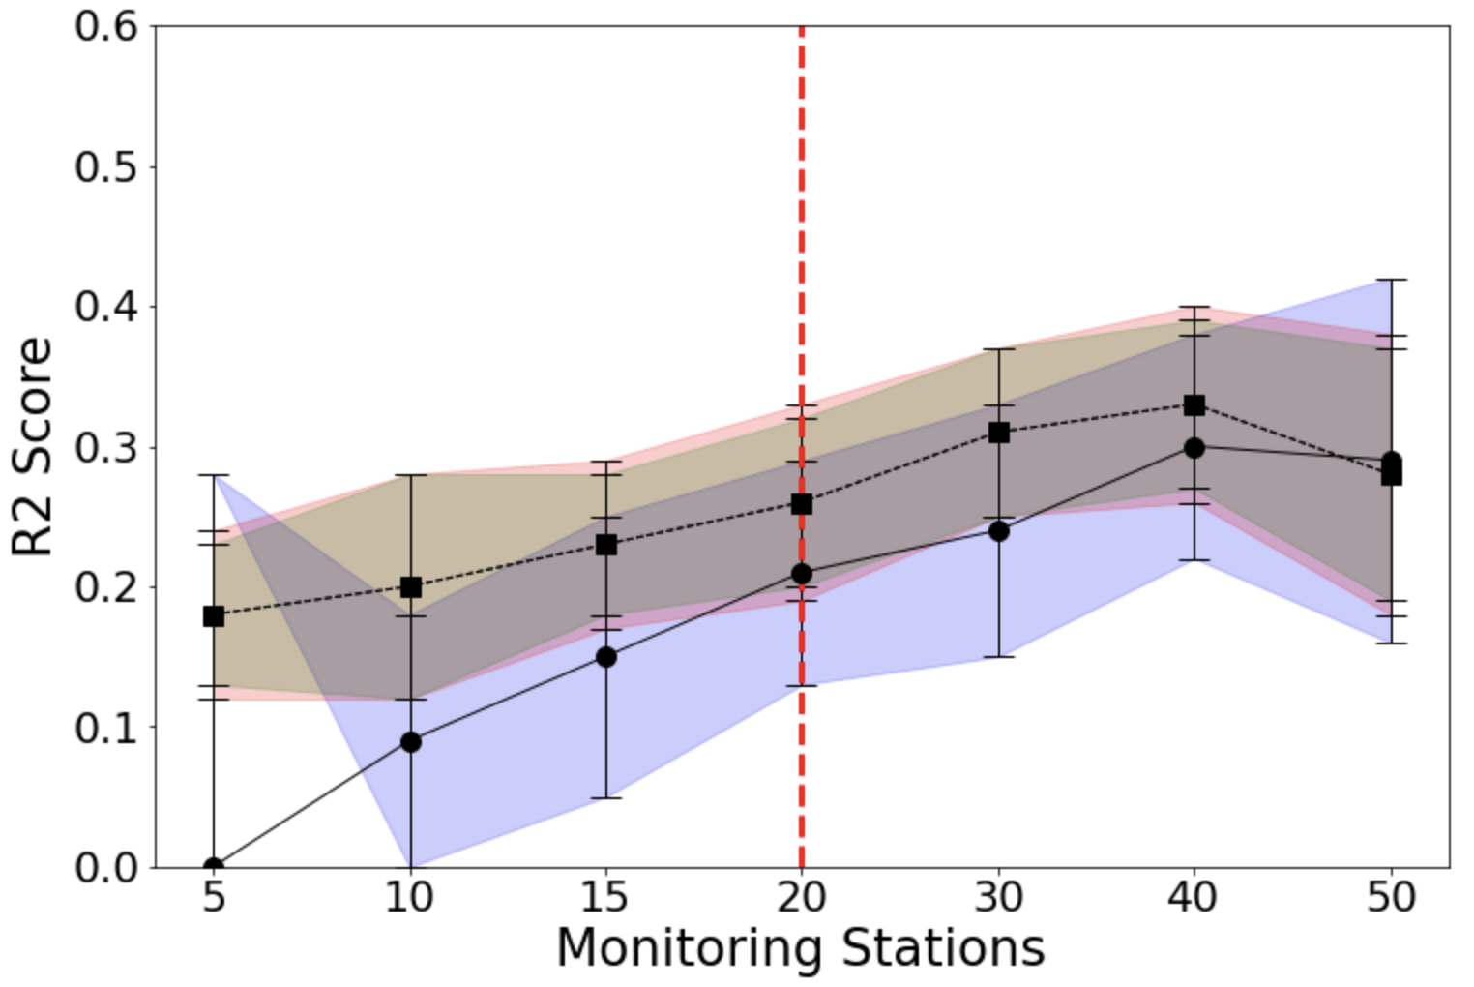
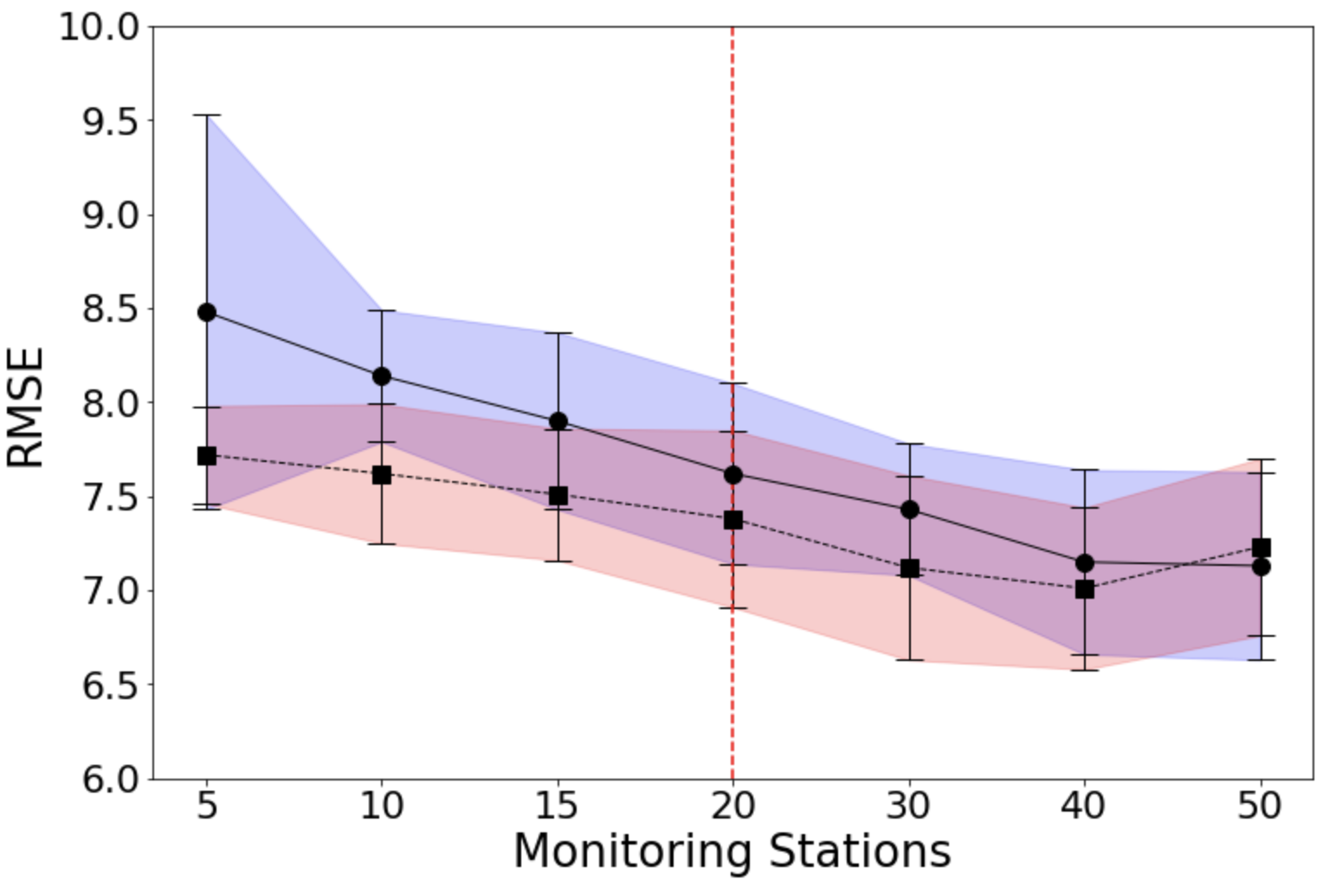
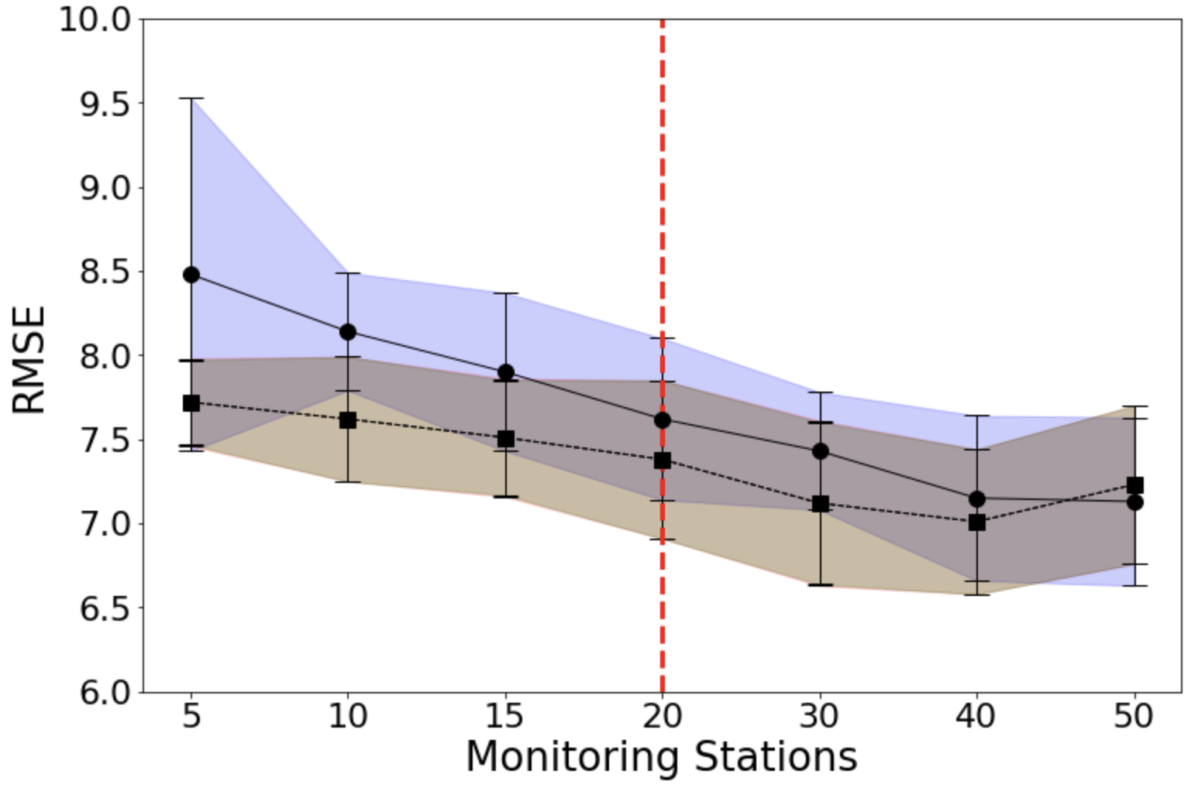

Slide 10
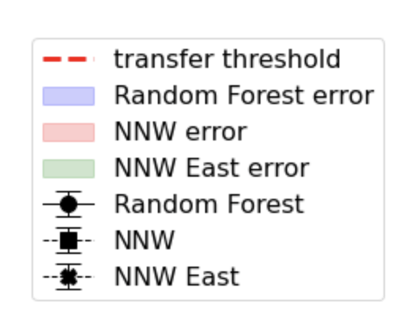
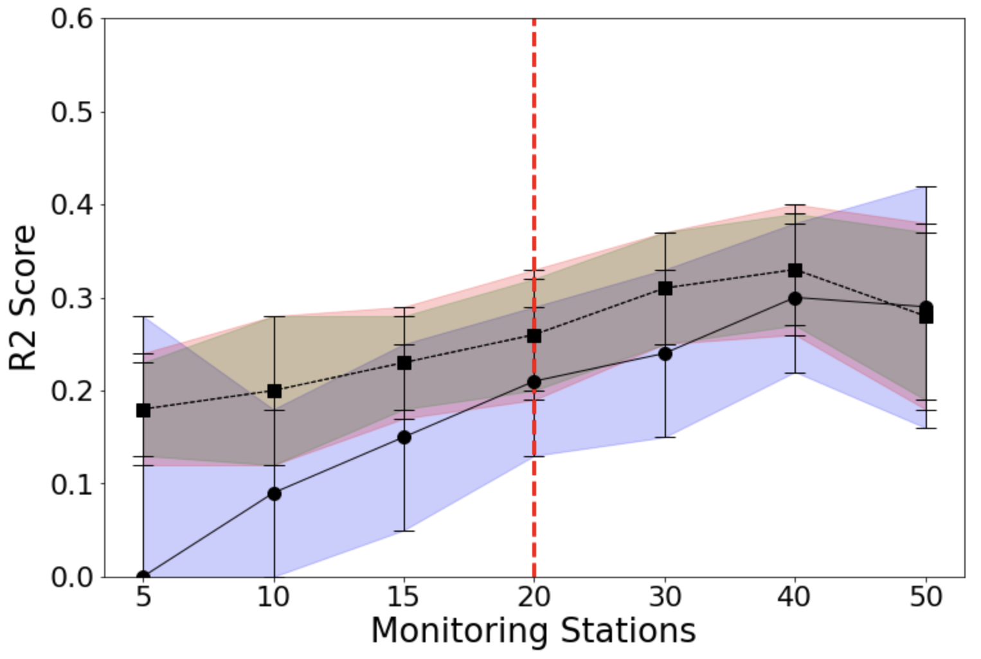

Slide 11
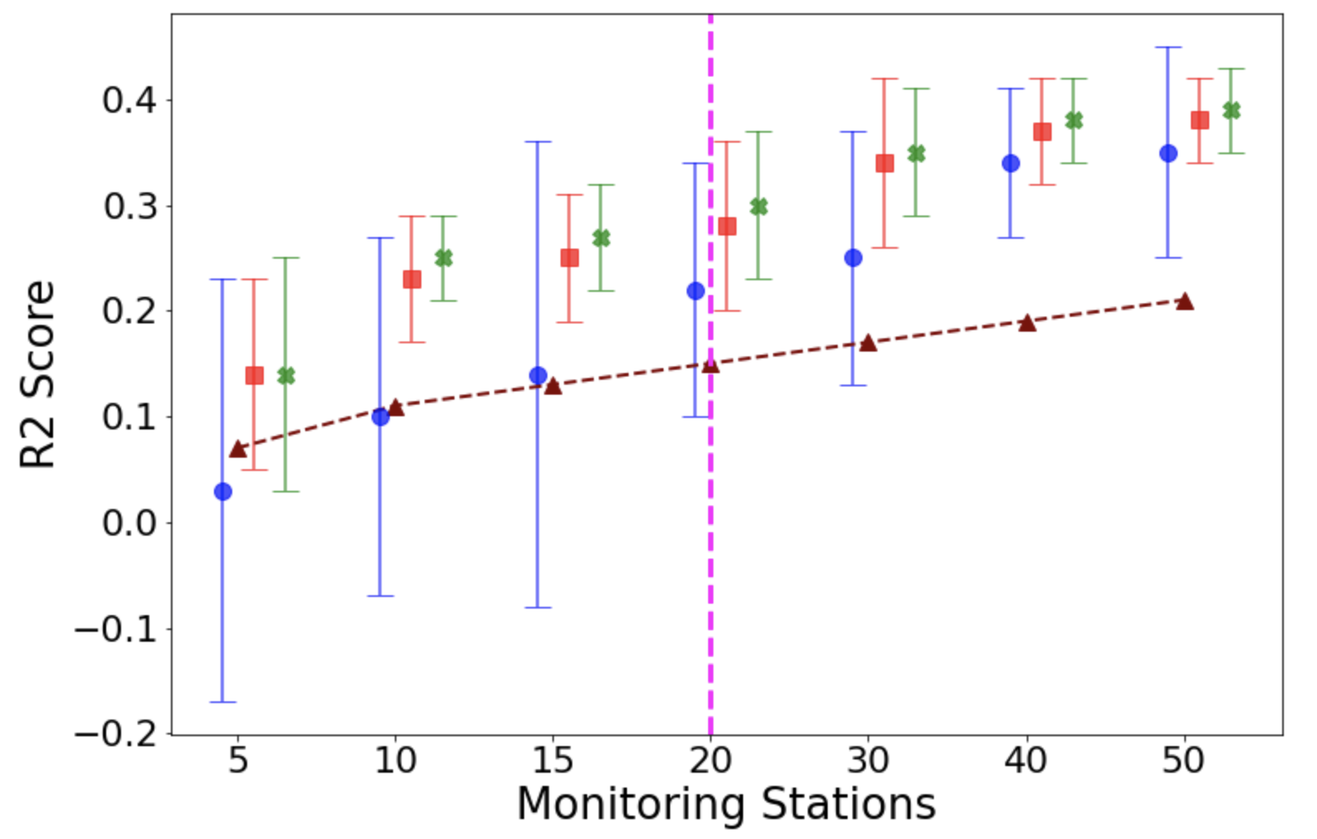
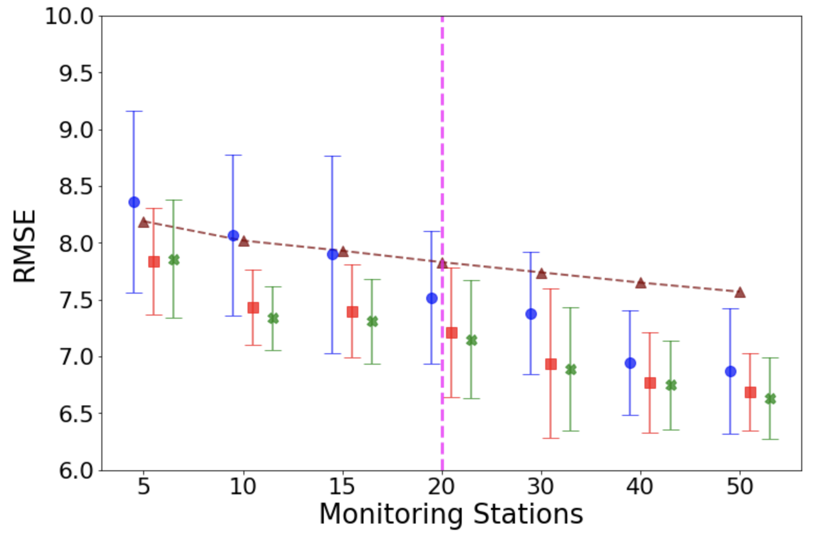
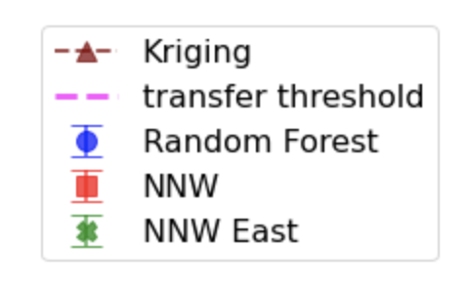

Slide 12
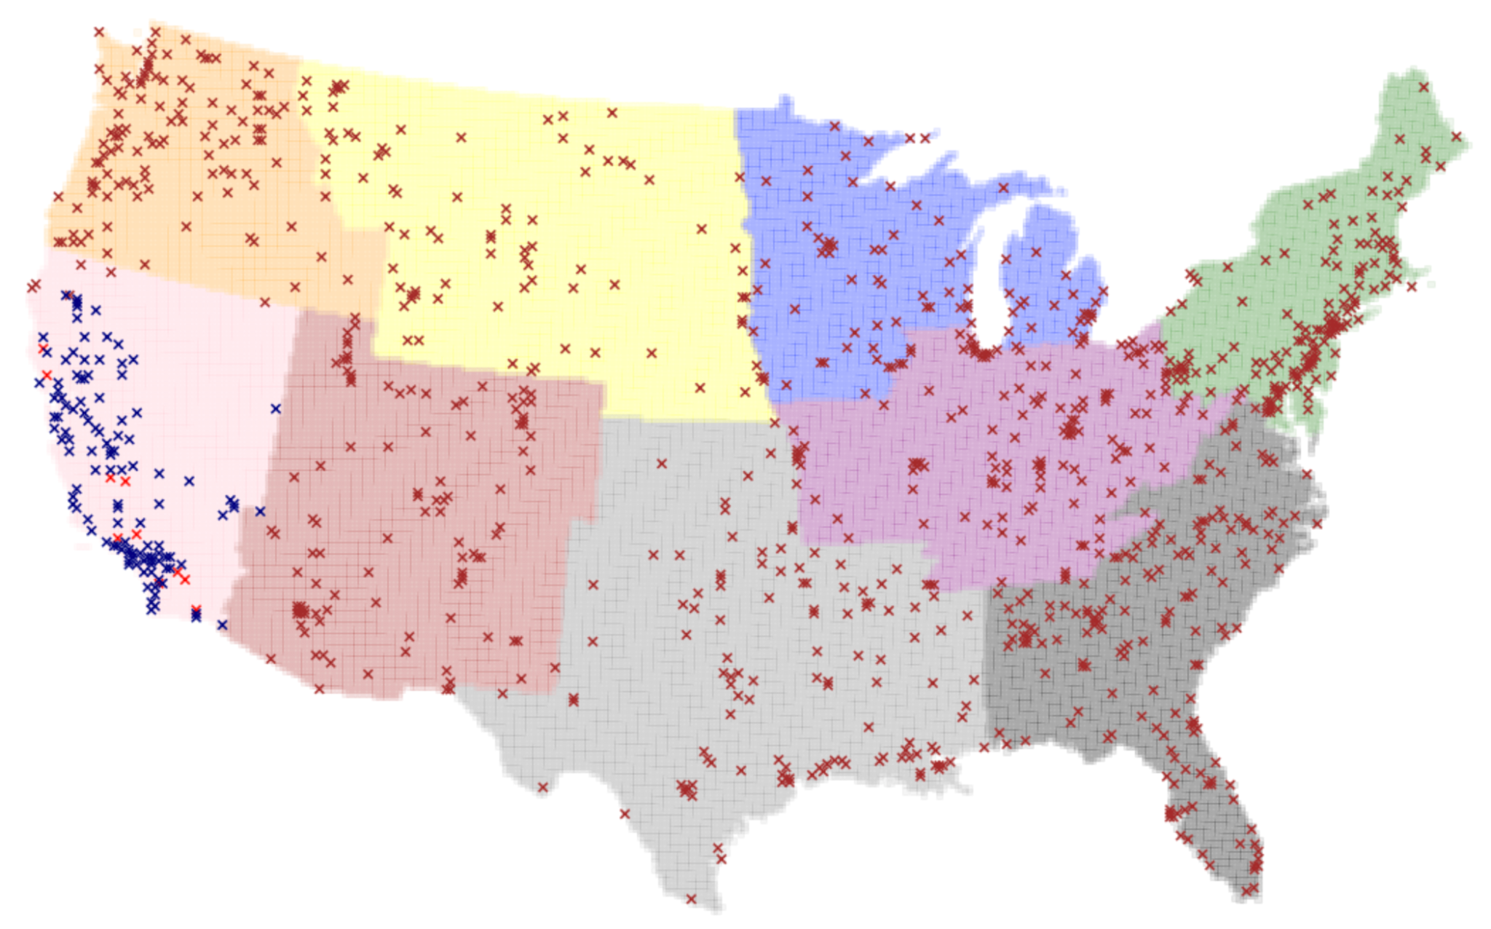
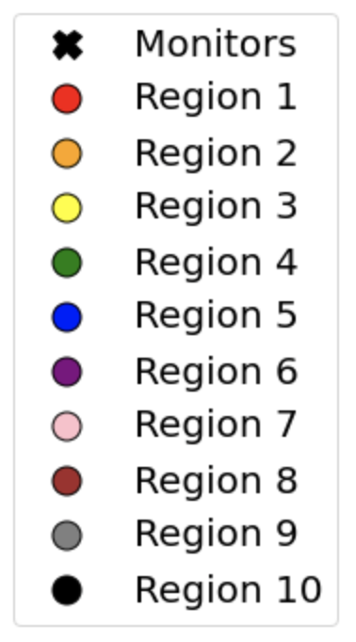

Slide 13
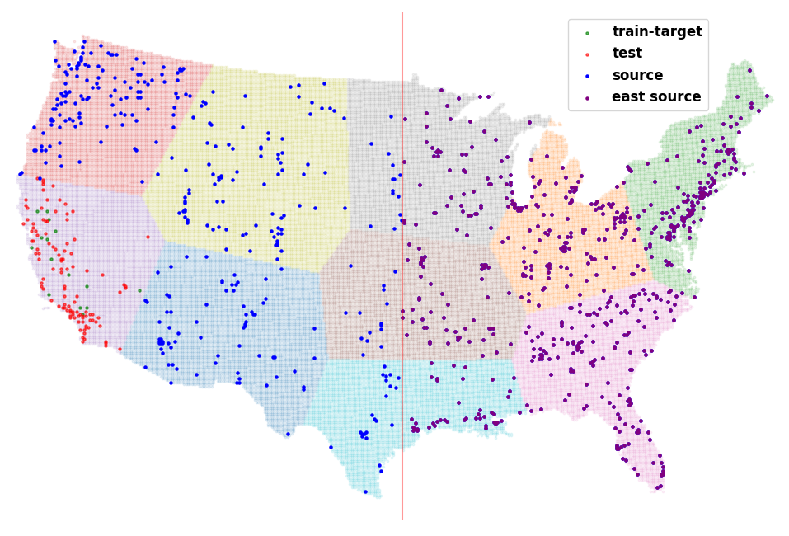

Slide 14
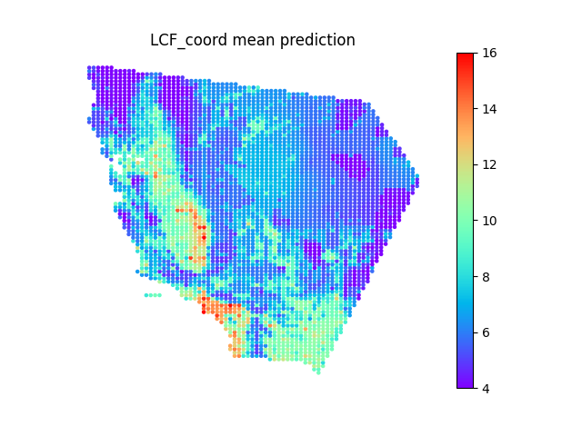
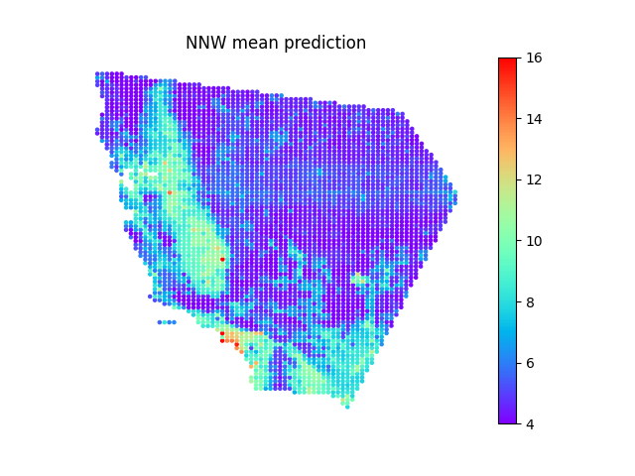
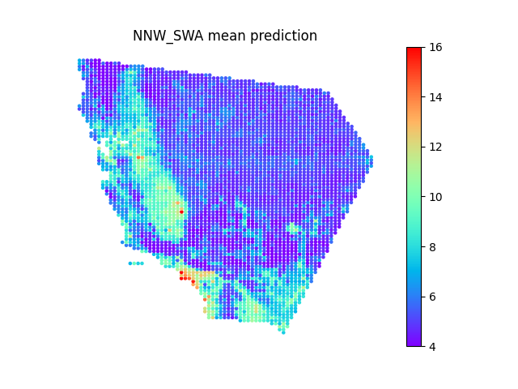
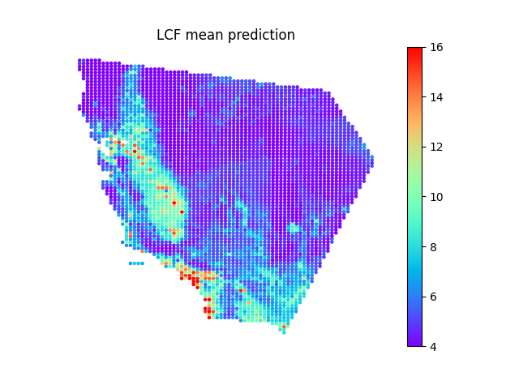
NNW Transfer
NNW w/ SWA Transfer
NNW w/ LCF Transfer
NNW w/ LCF-coord Transfer

Slide 15
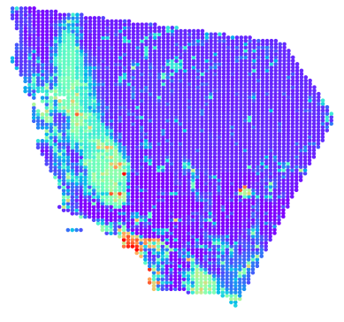
Random Forest (Target Only)
NNW Transfer
NNW w/ SWA Transfer
NNW w/ LCF Transfer
NNW w/ LCF-coord Transfer
Annual Mean Prediction (East Source)

Slide 16
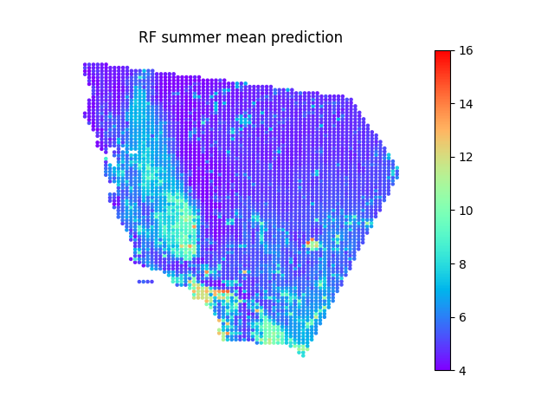
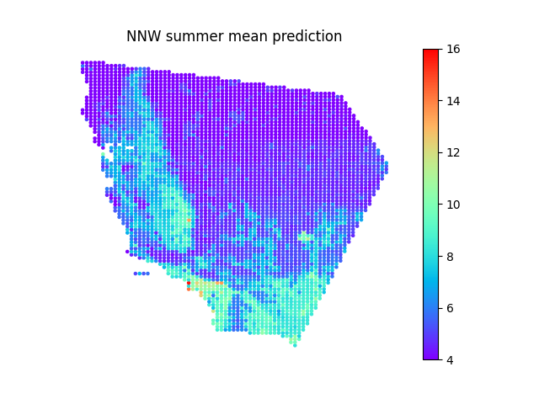

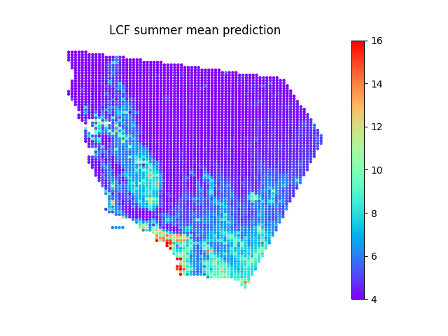
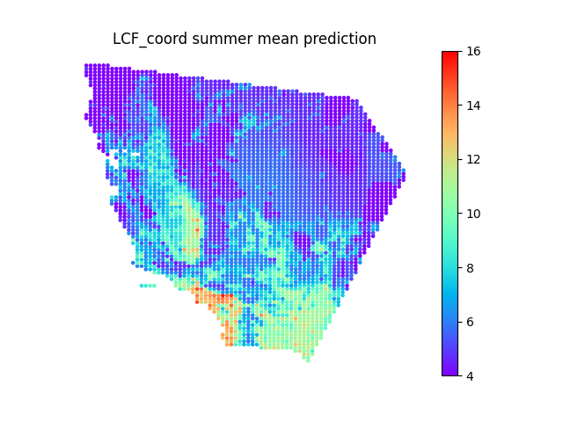
Random Forest (Target Only)
NNW Transfer
NNW w/ SWA Transfer
NNW w/ LCF Transfer
NNW w/ LCF-coord Transfer
Summer Mean Prediction (East Source)

Slide 17
Random Forest (Target Only)
NNW Transfer
NNW w/ SWA Transfer
NNW w/ LCF Transfer
NNW w/ LCF-coord Transfer
Annual Mean Prediction (East Source)
Random Forest (Target Only)
NNW Transfer
NNW w/ SWA Transfer
NNW w/ LCF Transfer
NNW w/ LCF-coord Transfer
Summer Mean Prediction (East Source)

Slide 18
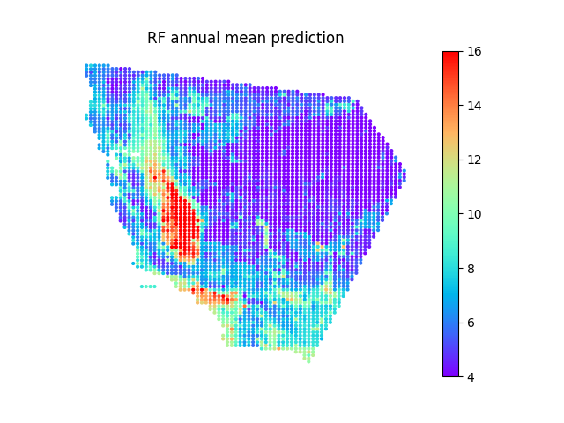
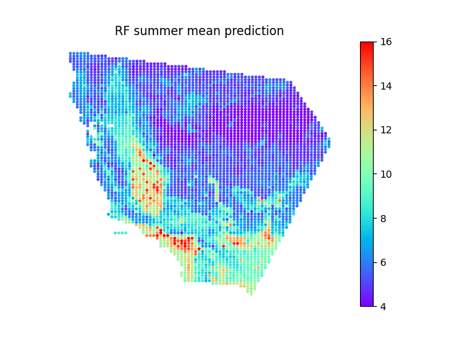
Annual Mean Prediction
Random Forest (Target Only)
NNW Transfer
NNW w/ SWA Transfer
NNW w/ LCF Transfer
NNW w/ LCF-coord Transfer
Summer Mean Prediction

Slide 19
Annual Mean Prediction
Random Forest (Target Only)
NNW
NNW w/ SWA
NNW w/ LCF-whole
NNW w/ LCF-coord
Summer Mean Prediction

Slide 20
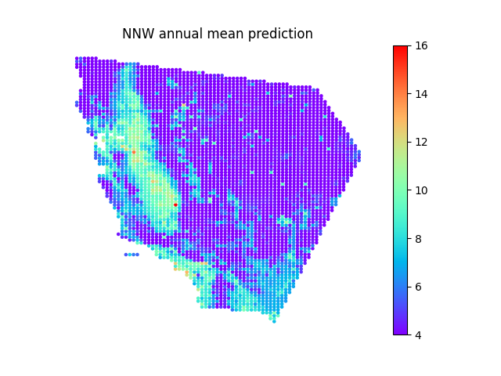
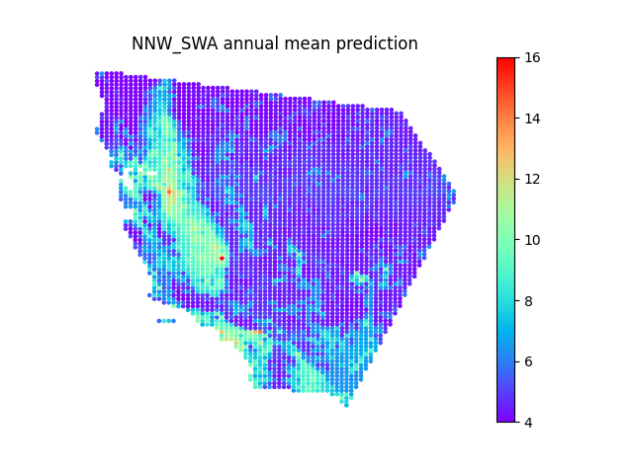
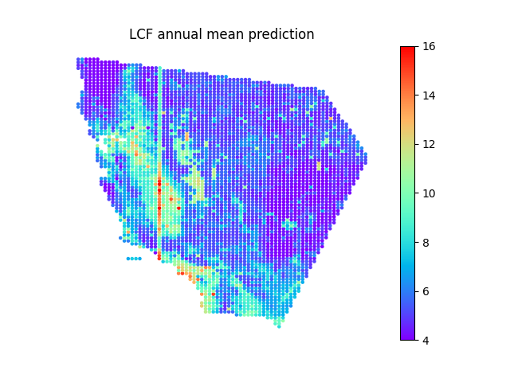
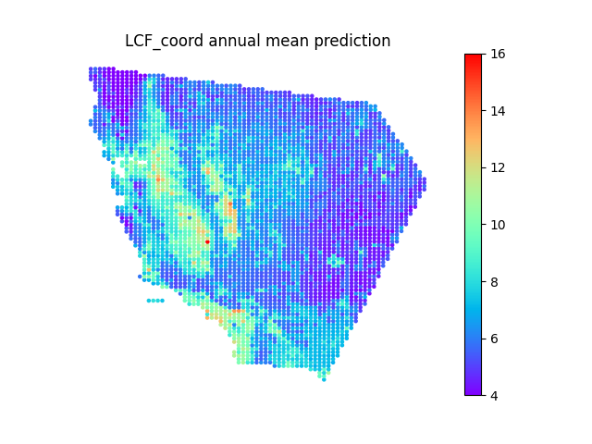
NNW Transfer
NNW w/ SWA Transfer
NNW w/ LCF Transfer
NNW w/ LCF-coord Transfer
Annual Mean Prediction (Whole Source)

Slide 21
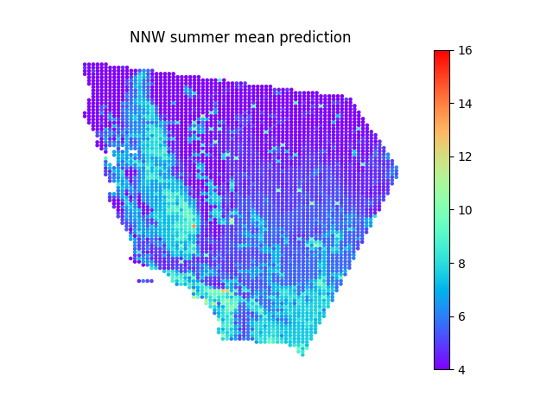

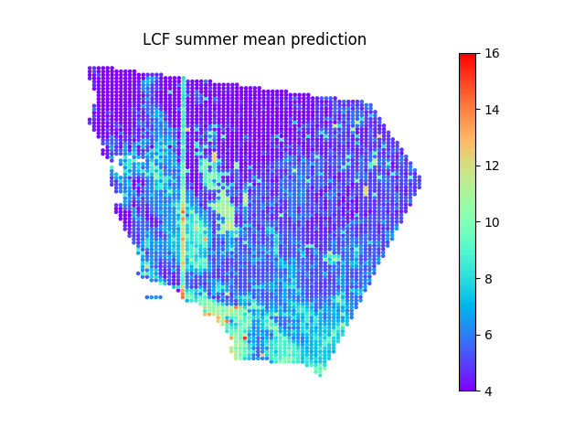
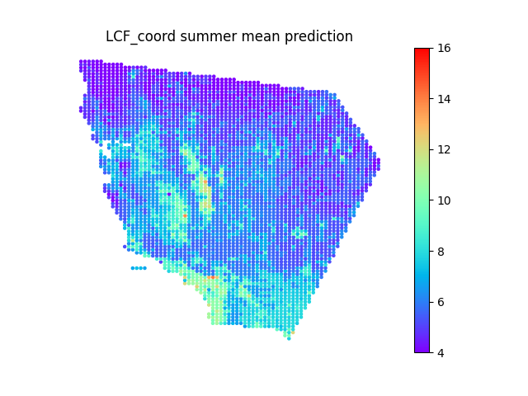
NNW Transfer
NNW w/ SWA Transfer
NNW w/ LCF Transfer
NNW w/ LCF-coord Transfer
Summer Mean Prediction (Whole Source)

Slide 22
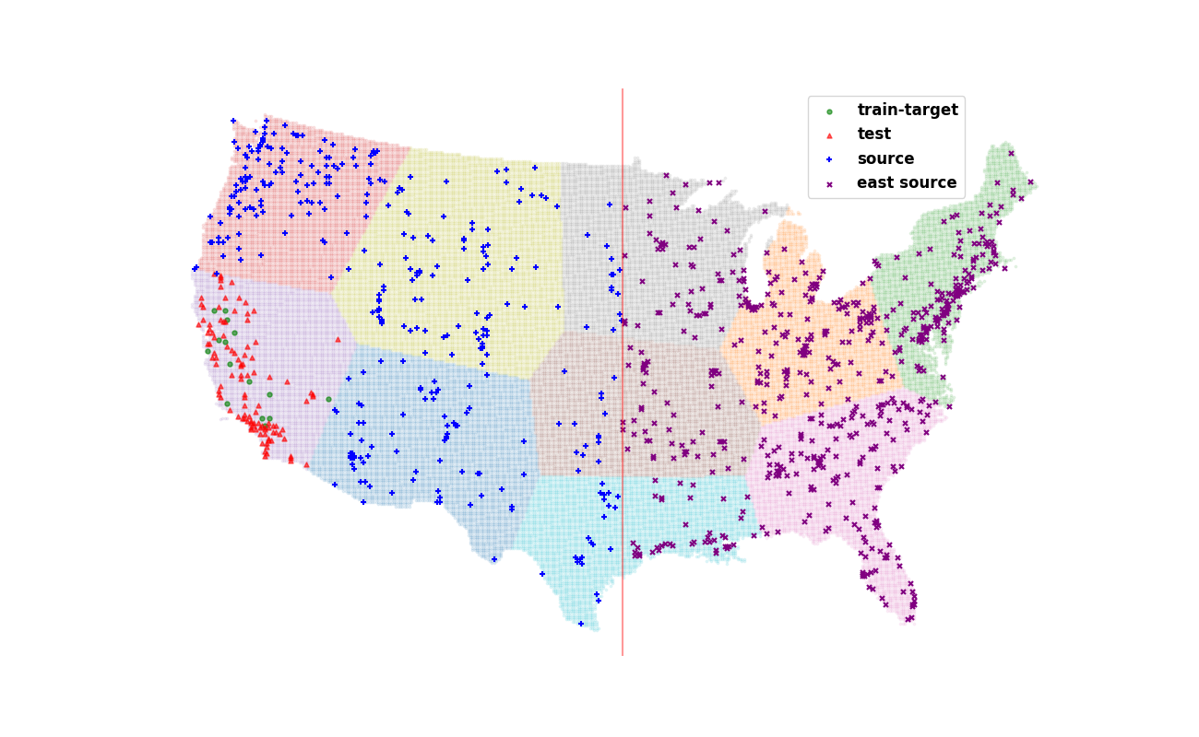

Slide 23
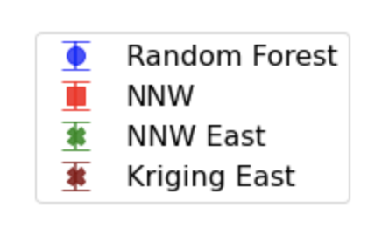
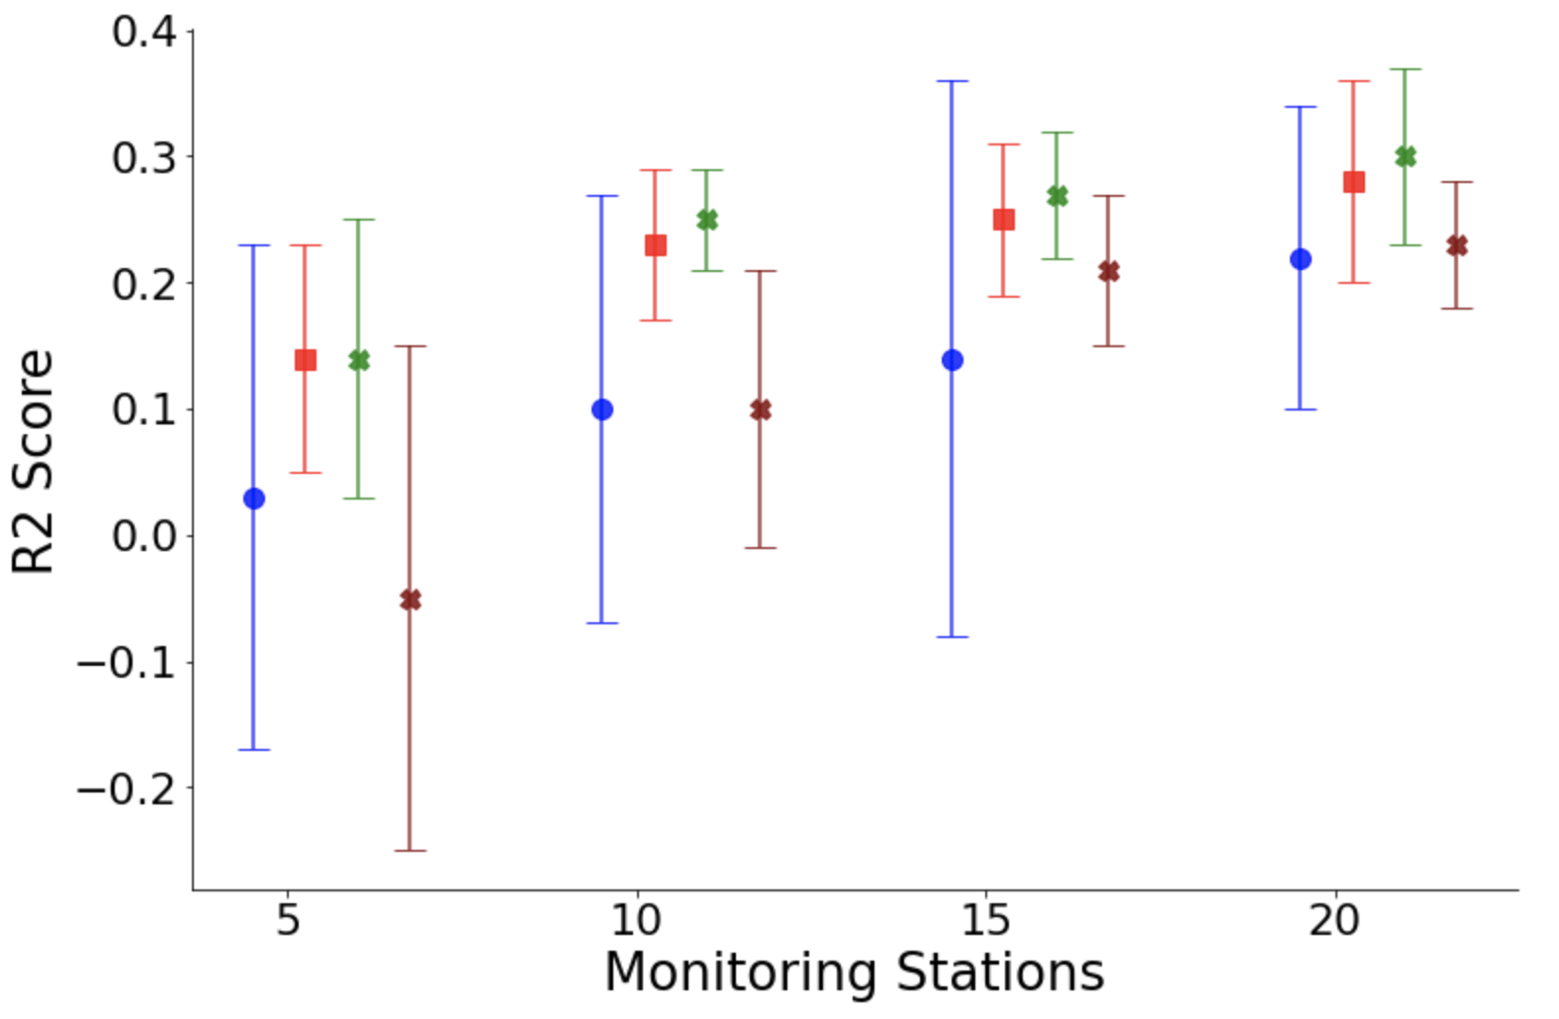
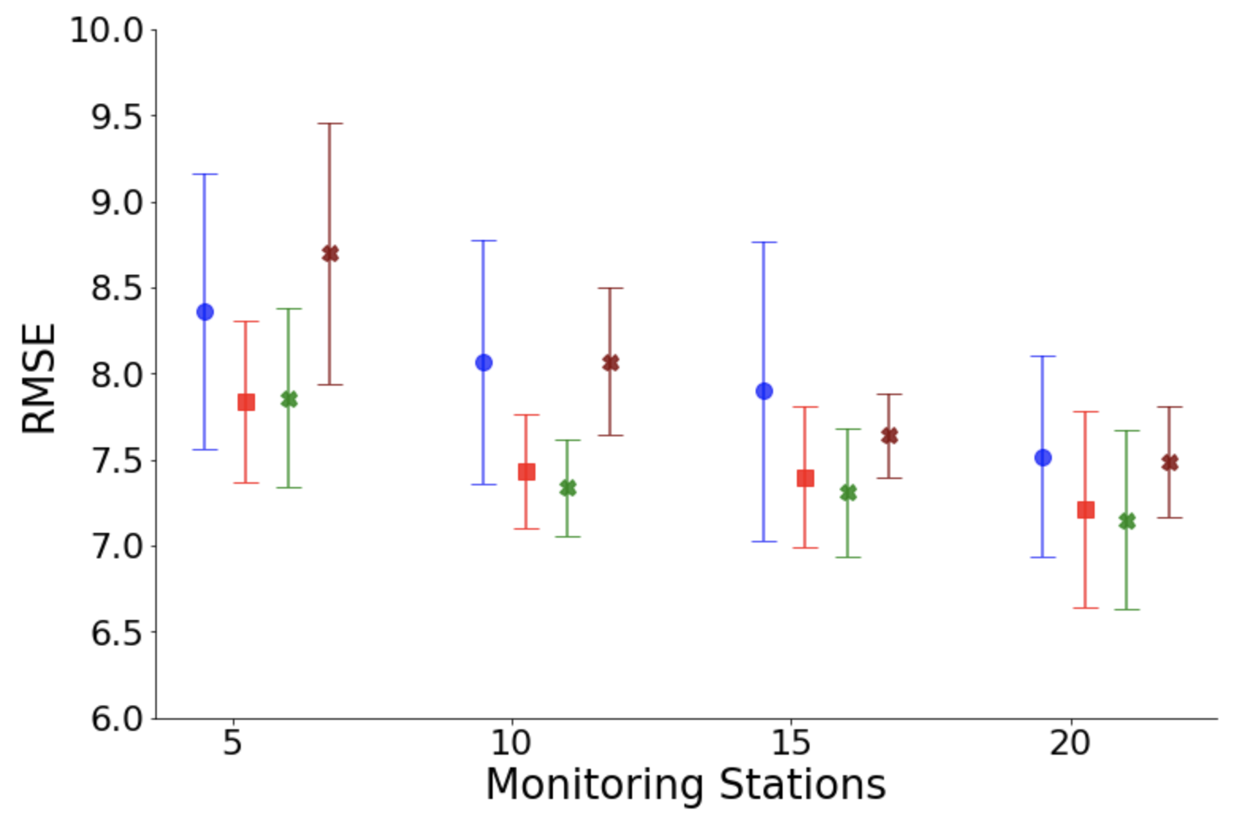

Slide 24
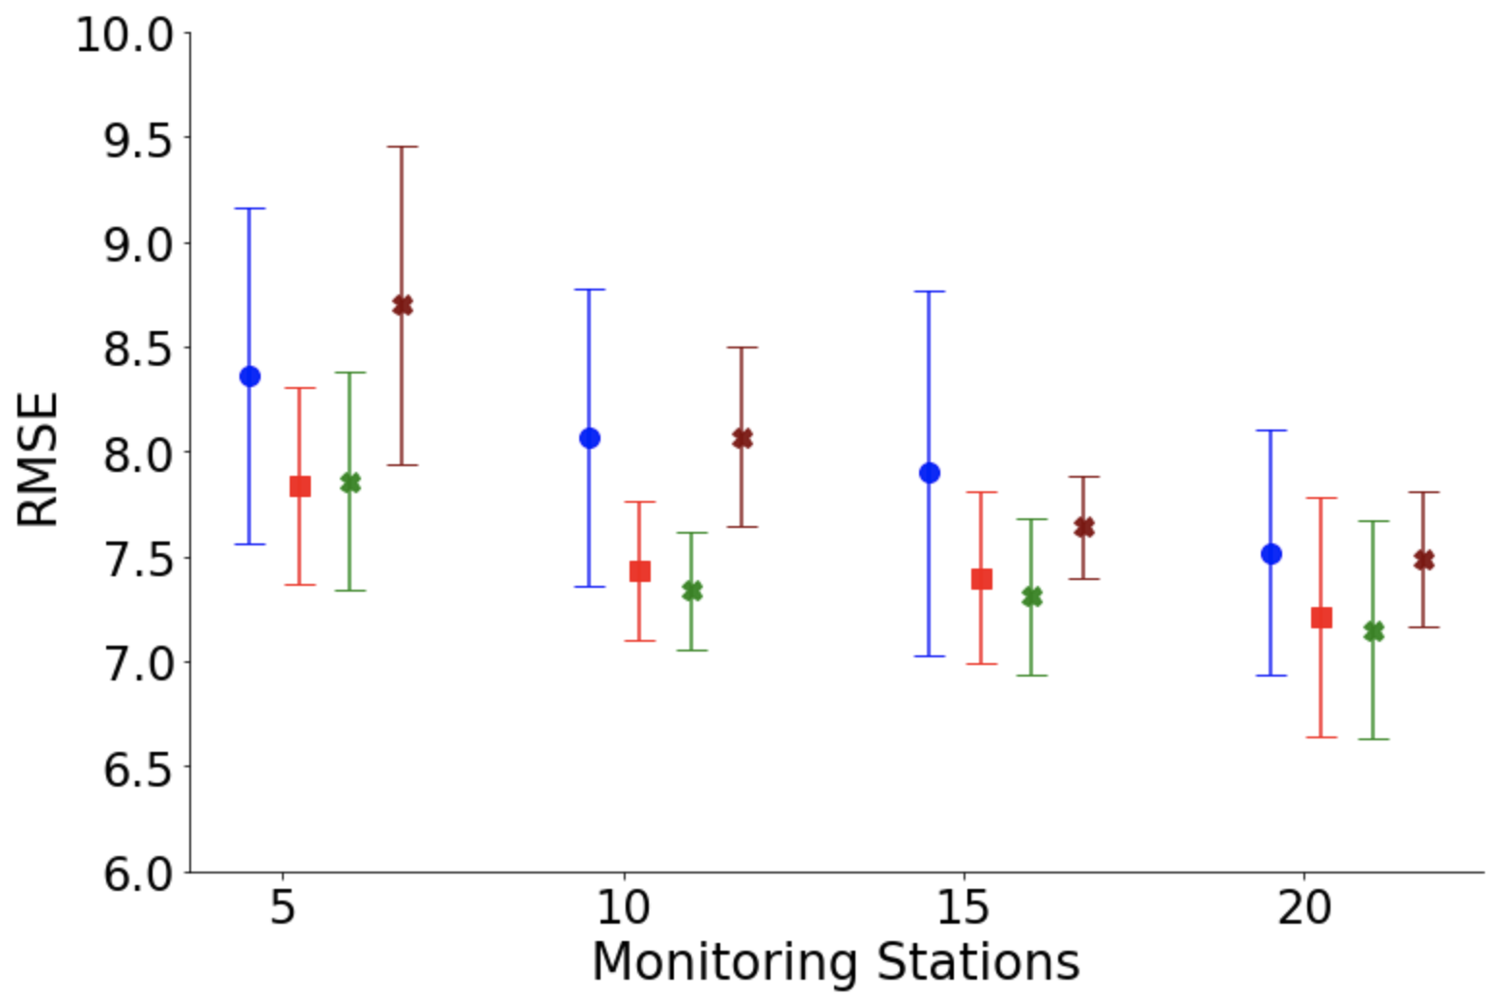
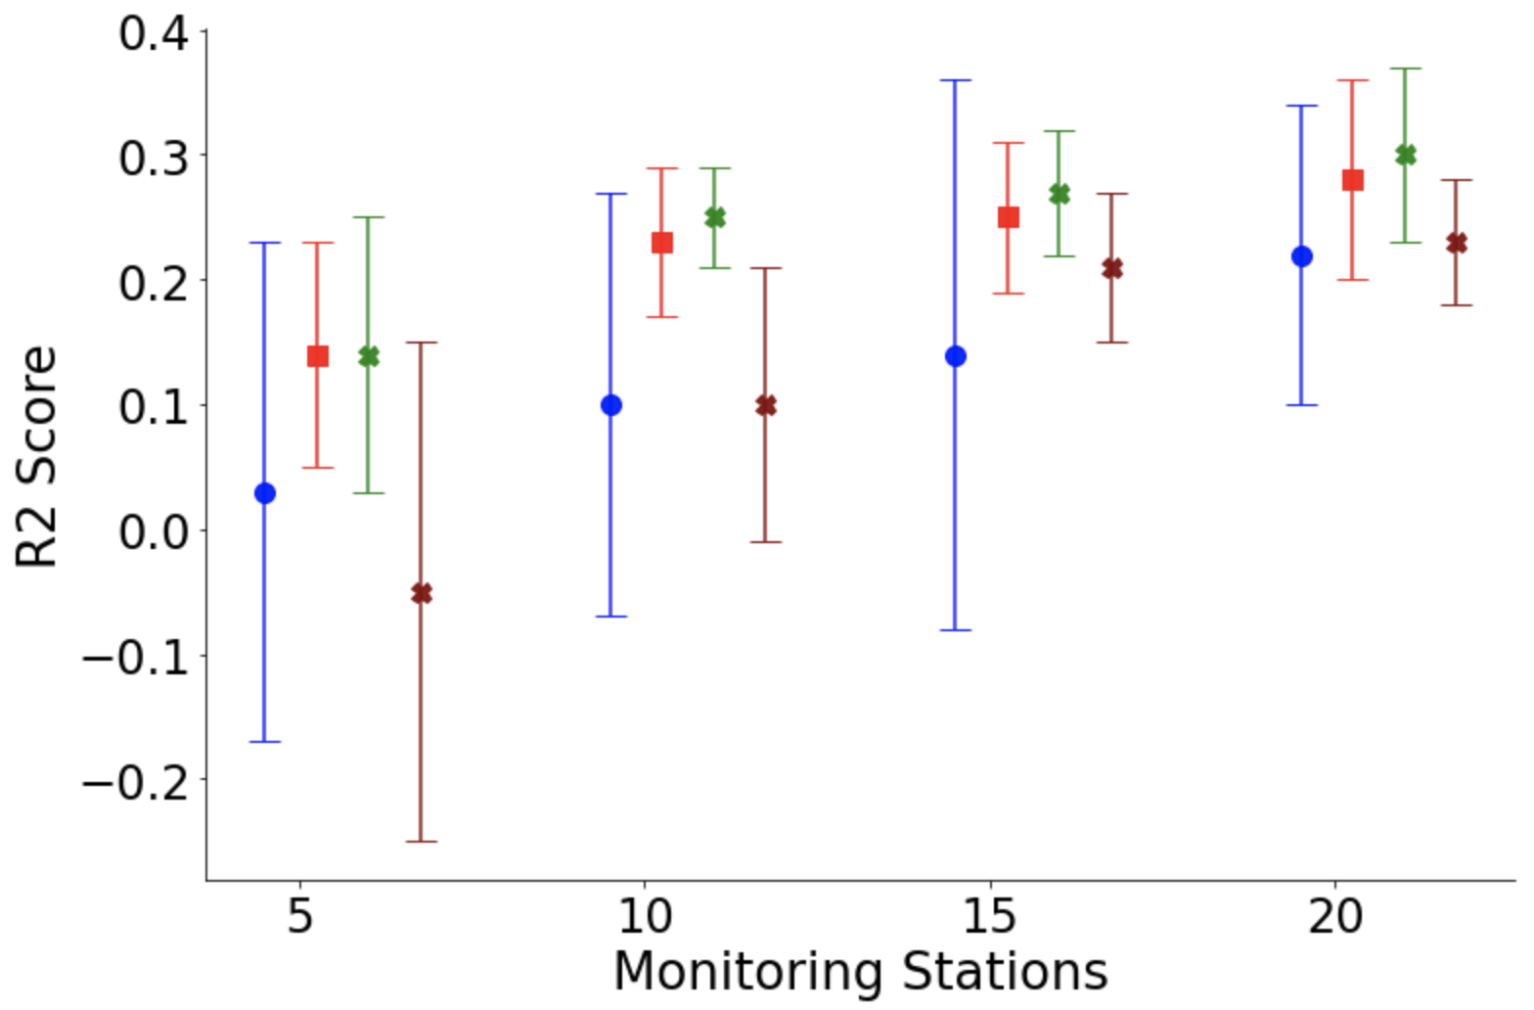
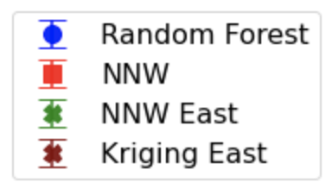

Slide 25
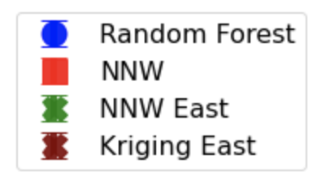



Slide 26





(a) Eastern US
(b) Whole US

